Slide 1
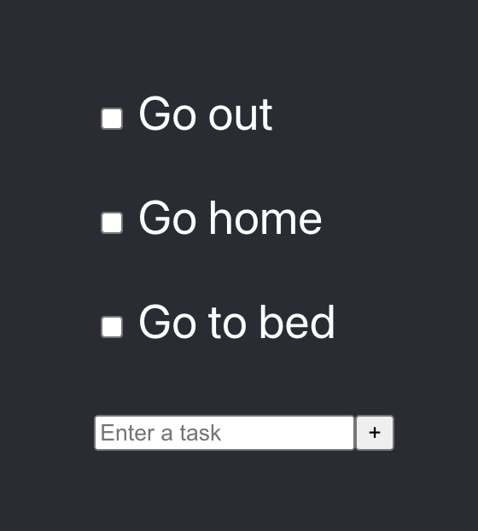
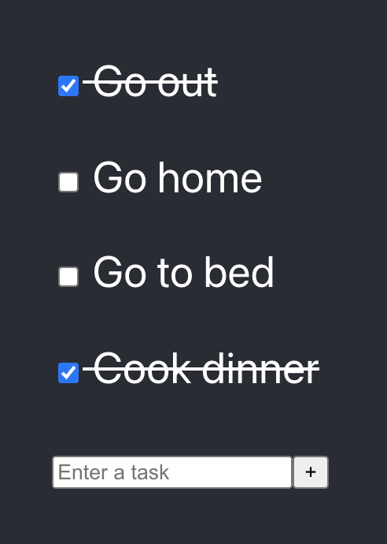
Todo-Sample
Notes:
ss

Slide 2
App.js
TodoParent
TodoItem
TodoItem
TodoItem
Addtodo

Slide 3
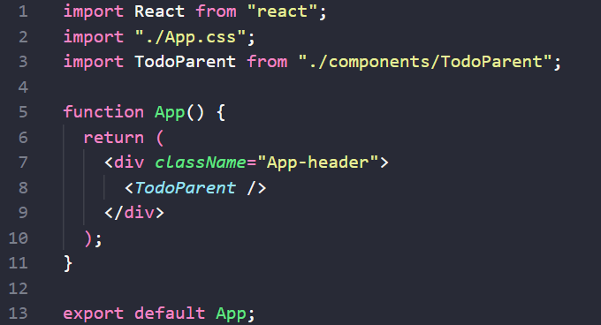
src/App.js:
The purpose of this file is to server as a top-level 'container' for everything that we might put in the app. Since our app only does 1(one) thing our App class is pretty short.
Notice that the file ends in .js instead of .jsx. For our purposes this is fine - your React app will run fine no matter which of those two file extensions you use.
Notes:
It is class components, extends components or react.comonents
It has render mandatory methods
The render will return the component to reneder on the screen
Noticed the import for the ./App.css
The background color
The text is centered

Slide 4
What does the TodoParent do?

Slide 5
App.js
TodoParent
const startingState = [
{ id: 1, title: "Go out", completed: false },
{ id: 2, title: "Go home", completed: false },
{ id: 3, title: "Go to bed", completed: false },
];
const [todoArray, setTodoArray] = useState(startingState);
markComplete = (id) => {…}
addTodo = (newTitle) => {…}
TodoItem
TodoItem
TodoItem
Addtodo

Slide 6
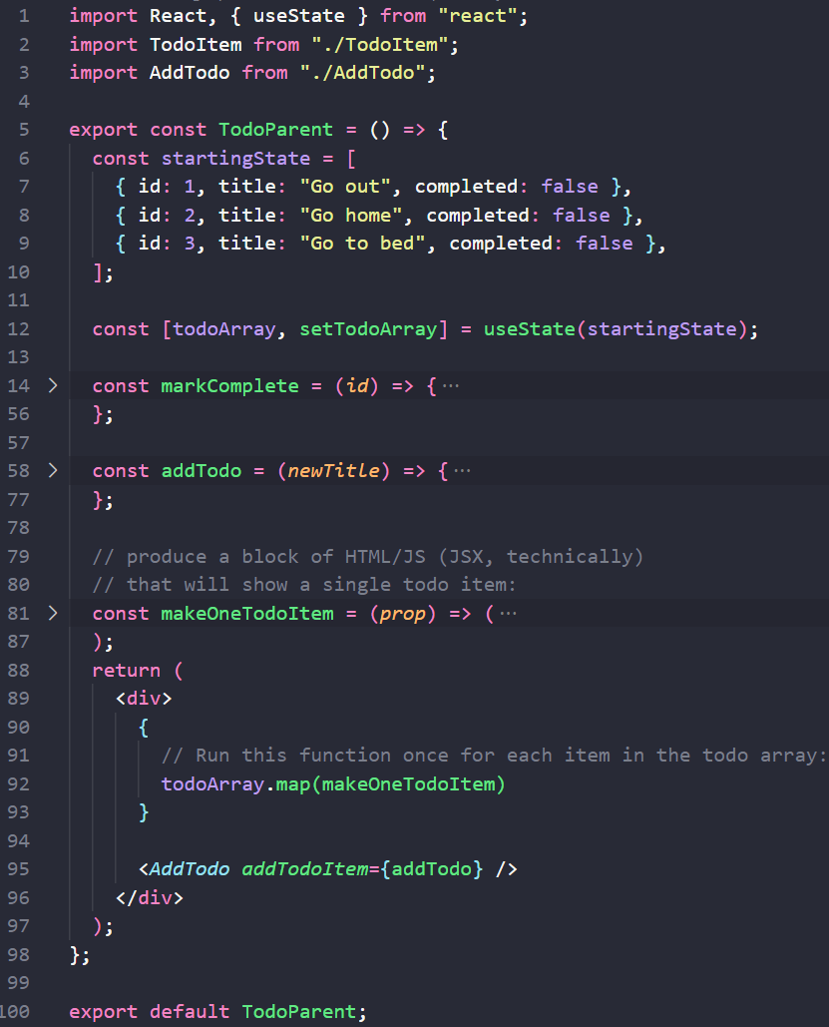
src/components/todoparent.js:
TodoParent is a container component,
its job is to contain all the stuff the user sees in the todo list and to store all the data that any of it's parts need.
The state object is a special instance variable that React looks for. When this changes React will re-render the page. We will need to tell React when it changes
Instead of using a constructor we'll initialize state directly.
for the rest of the life of the program, we will update the state by calling the setTodoArray method with a brand-new object literal.
After creating the state do not change the state directly
Notes:
The purpose of this file is to contain everything needed to display the list of todo items, and to respond to any user input (specifically, when the user checks off an item the item should be crossed out, when a user unchecks an item it should be un-crossed-out)
We create the states here it here and then, for the rest of the life of the program, we will update the state by calling the setState method with a brand-new object literal. After creating the state do not change the state directly - call .setState() with the new state object literal!
the render() method:
The Render method is intended to display a list of the currently existing todo items, and to display a textbox that allows the user to add new todo items
Displaying each item will be handled by the TodoItem component, so this method is focused on producing a list of those individual items.
Point out that this.state.todo is actually an array of the individual items - this was the state variable back in the TodoParent class
Highlight the call to .map(), and the use of the makeOneTodoItem function
<This component has 3 more methods
markComplete
One to handel the change in the toddoitems when addTodo
And MakrkedDoneToDoItem
Talk about the import and the export

Slide 7
What does the TodoItem do?

Slide 8
App.js
TodoParent
const startingState = [
{ id: 1, title: "Go out", completed: false },
{ id: 2, title: "Go home", completed: false },
{ id: 3, title: "Go to bed", completed: false },
];
const [todoArray, setTodoArray] = useState(startingState);
markComplete = (id) => {…}
addTodo = (newTitle) => {…}
TodoItem
props
const { id, title } = props.todo;
props
TodoItem
const { id, title } = props.todo;
props
TodoItem
const { id, title } = props.todo;
Addtodo

Slide 9
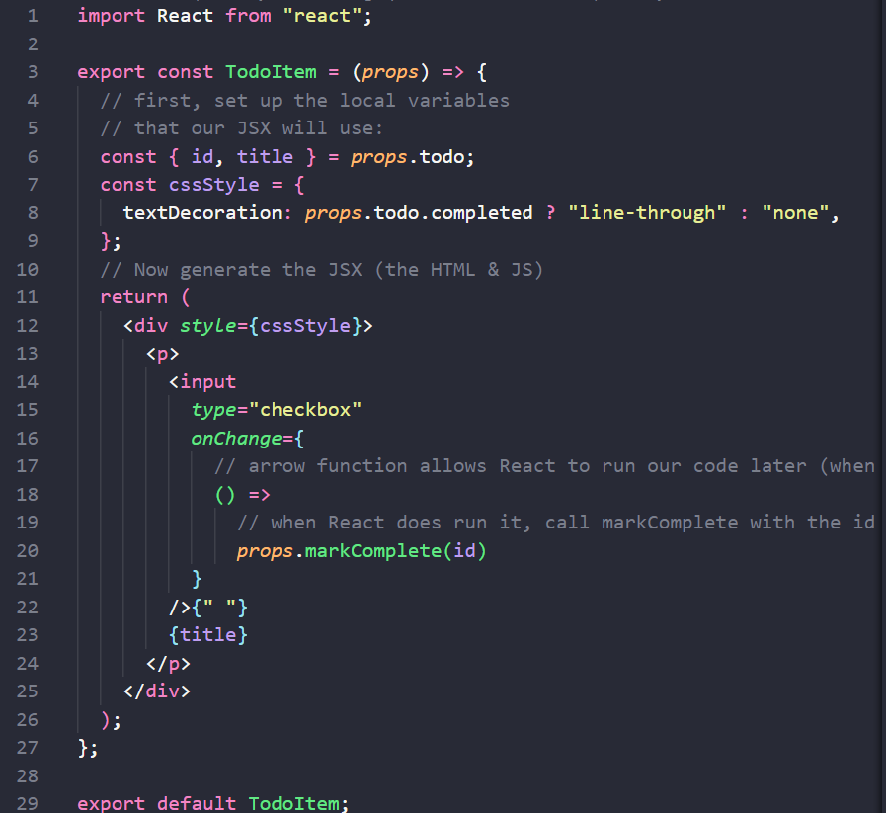
src/components/TodoItem.js:
The purpose of this file is to display a single todo item.
It also sets things up so that when the user clicks on the checkbox the item will be marked as 'completed', which will trigger/cause the item to re-render.
Notes:
render() starts by "deconstructing" (unpacking) the props into local variables (local constants)
Next, point out the cssStyle object literal
This is a 'style object' - an object literal that React uses to set up CSS for this element
textDecoration is the same as the CSS text-decoration property. JS doesn't allow hyphens/dashes in variable names so React expects us to remove the dash & camel case the variable.
Point out the ? : operator - it's a compact if/else
Point out that it returns JSX, and that the { } pairs switch from HTML to JavaScript
The goal for this file is to set things up so that when the user clicks on the checkbox then markComplete will get called (and ONLY when the user clicks on the checkbox - do NOT call it before then!)
Point out how the checkbox input, and the space, and the title variable are put onto the page, in the source code
Point out the onChange event handler, and what it does
Point out the arrow function
Allows us to define a function that will be called later (NOT when the item is rendered on the page - that would be too soon).
Point out that we're fixing / binding the parameter when we define the arrow function.
We are creating a brand-new function for each and every todo item

Slide 10
How an item's completed status is toggled in the sample app

Slide 11

React re-renders the parts of the page that have changed
App.js
TodoParent
const startingState = [
{ id: 1, title: "Go out", completed: false },
{ id: 2, title: "Go home", completed: false },
{ id: 3, title: "Go to bed", completed: false },
];
const [todoArray, setTodoArray] = useState(startingState);
markComplete = (id) => {…}
addTodo = (newTitle) => {…}
TodoItem
props
const { id, title } = props.todo;
<input type="checkbox"
onChange={ () => props.markComplete(id) }
/>
TodoItem
const { id, title } = props.todo;
<input ... />
TodoItem
const { id, title } = props.todo;
<input ... />
Addtodo

Slide 12
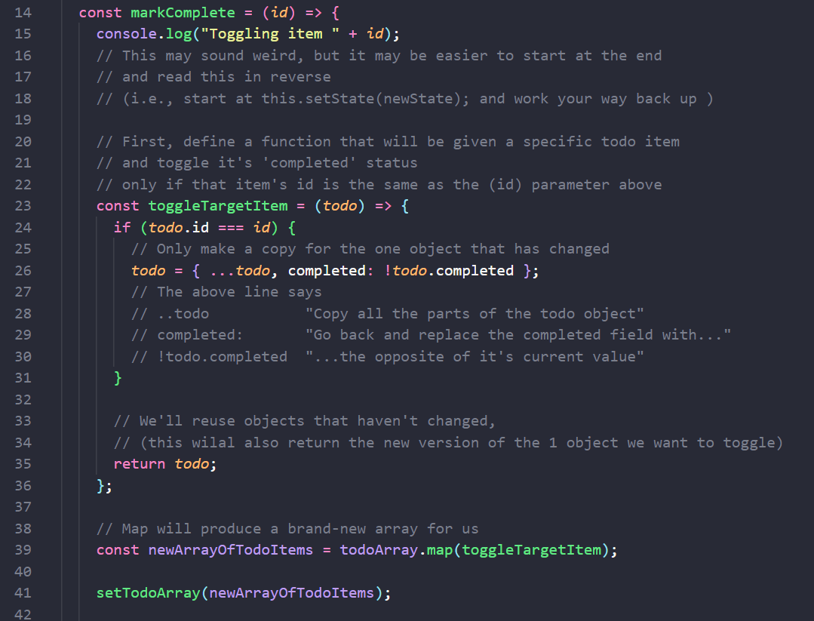
src/components/Todoparent.js:
markComplete()
Notes:
Read the function from top to button
The goal of this file is to store the state (think of this as the 'global variables' for your app), and to define functions that allow other components to modify the state
Point out that we create the state here, using an object literal.
We also could have used a constructor method instead
markComplete function: probably better to name this toggleCompleted, but I'm sticking with the example in that blog post, so here we are :)
We also use the fat arrow syntax to create a new function to toggle the state of a particular item.
The fat arrow will use 'this' from the surrounding code. In other words, it uses the same 'this' as the TodoParent class around it.
So this.setState() changes the state in the TodoParent object NOT on the component that calls markComplete
There's two versions of this - the first separates all the steps out, the second jams everything into a single statement
Goal: We need to create a new copy of whichever item was toggled, and then re-use the existing objects for the unchanged items
WARNING: This is different than the original tutorial, which incorrectly modified the object in-place instead of making a copy.
Highlight how we create a function (toggleTargetItem) that will check if the item it's given is the one we want to toggle. If so, create a brand-new object literal with the completed field toggled; if it's not the item we want to toggle then hand that same object back via return.
Highlight how 'map' creates a new array; toggleTargetItem is used to get the unchanged original todo item or the brand-new copy of the toggled target item.
Highlight the object literal that we create and store into a local variable
(This is easy to missin the 'everything jammed into a single statement' version - it's the { and } has a single field inside it)
Highlight how we set the 'todo' field in the object literal (because the new object needs to have the same shape as the existing state object)

Slide 13
Adding New items to the list

Slide 14
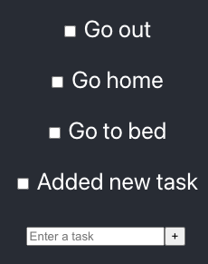
React re-renders the parts of the page that have changed
App.js
TodoParent
TodoItem
const startingState = [
{ id: 1, title: "Go out", completed: false },
{ id: 2, title: "Go home", completed: false },
{ id: 3, title: "Go to bed", completed: false },
];
const [todoArray, setTodoArray] = useState(startingState);
markComplete = (id) => {…}
addTodo = (newTitle) => {…}
TodoItem
TodoItem
TodoItem
props
Addtodo
<input type="text" placeholder="Enter a task" ref={input} />
<button
onClick={() => {
props.addTodoItem(input.current.value);
input.current.value = "";
}}
>
{" + "}
</button>

Slide 15
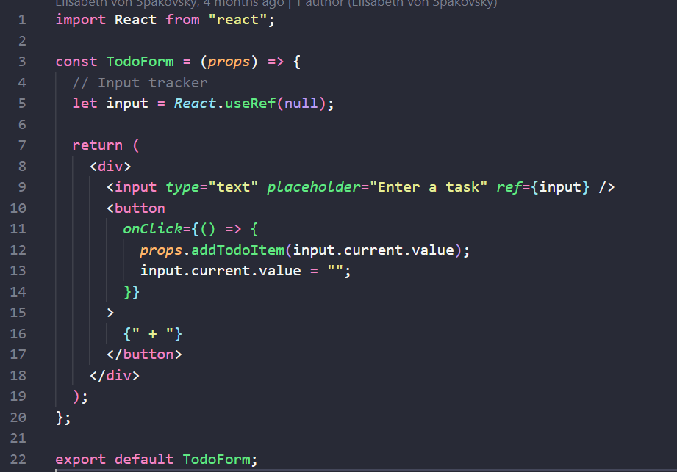
src/components/AddTodo.js :
There are two goals of this component:
keep track of what the user has typed in by connecting an instance variable to the textbox, so that we can get the contents of the textbox when the button is clicked.
Then, when the user clicks on the plus button, call the addTodoItem function so that TodoParent can add the new todo item
Notes:
To keep track of changes in input, we used to do it by updating component state.
On Render method we had
<form onSubmit={this.onSubmitHandler}>
<input type="text" value={this.state.name} onChange={this.onChangeInput} />
<input type="submit" />
</form>
//onChange props methods update the state value
onChangeInput = (e) => {
this.setState ({name: e.currentTarget.value})
//this.setState( state => (return { name: e.currentTarget.value }));
};
state = {
name: "",
}
Move Next slide

Slide 16
src/components/AddTodo.js :
There are two goals of this component:
keep track of what the user has typed in by use the ref attribute to the textbox, inside a function component , so that we can get the contents of the textbox when the button is clicked.
Then, when the user clicks on the plus button, call the addTodoItem function so that TodoParent can add the new todo item
2
1
3
Notes:
In this example we don’t have state for the components all states handeled by the todoParent
We keep track of the user's input via an instance variable which stores a reference (a ref) to the textbox's DOM object
We use it to get the value out of the textbox at any time; we'll wait until the user pushes the button
We need to establish the connection so that we can remove the user's text after we add the new item.
We create the ref via this line of code in the constructor: this.input = React.createRef();
The <form> is an HTML element that tells the browser: everything between the opening <form> and closing </form> tags are all related - they're all part of the same form.
There's more information online about forms
The <input type="text"> tells the browser to put a text box on the page (as opposed to a button, a checkbox, etc).
placeholder="Enter a task" tells the browser to put the text "Enter a task" inside the box only until the user types something in (at which point it'll show whatever you've typed).
ref={this.input} tells React that when the textbox is created to establish a reference between the input instance variable and the DOM node (i.e., the textbox)

Slide 17
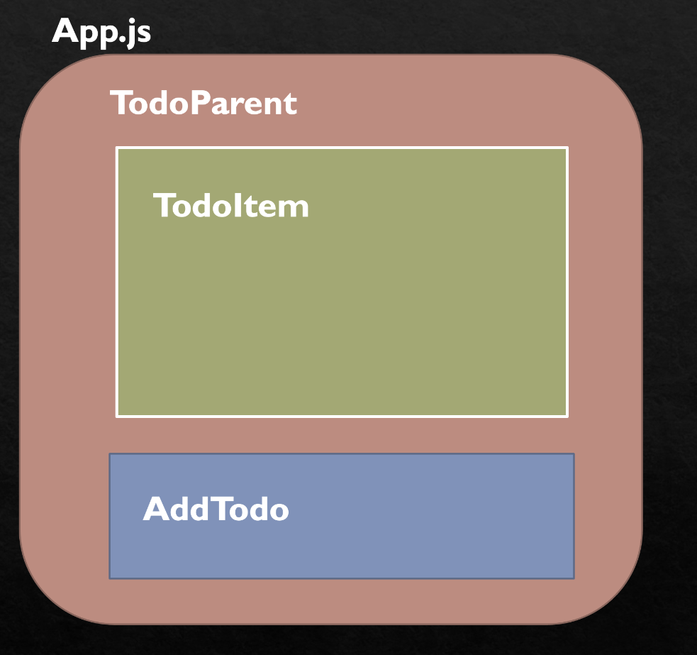
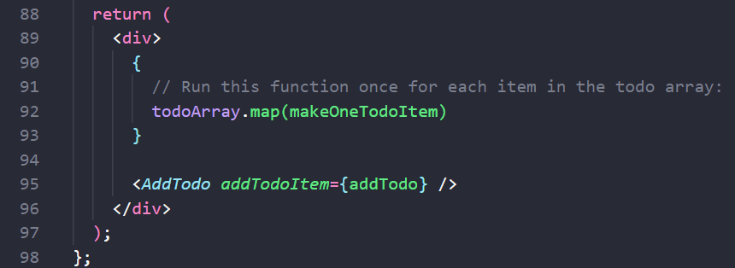
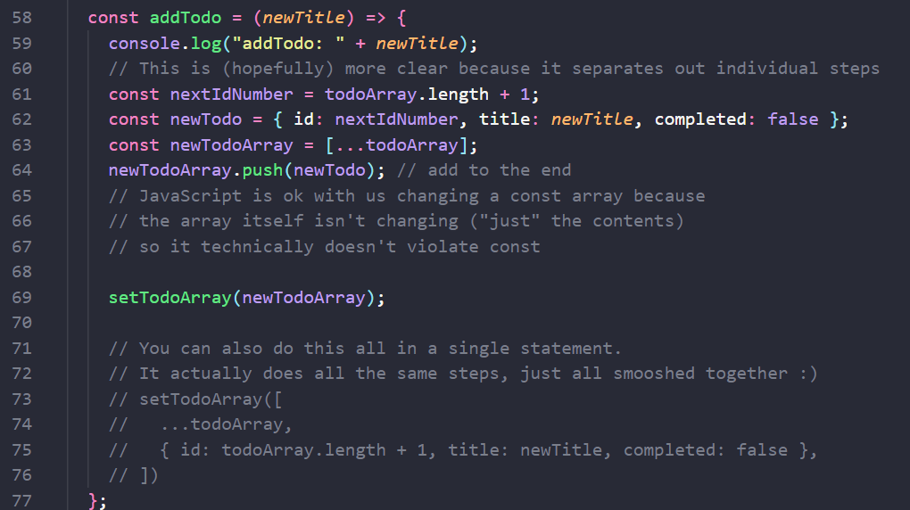
Adding New items to the list
TodoParent.js
TodoParent.js
AddTodo.js

Slide 18
src/components/Todoparent.js:
addTodo()
We'll add the addTodo function which needs to create a new object literal for the todo item itself
AND ALSO create a new array and a new state object. Most of the complexity of this function comes from needing to leave the original state untouched and instead to make a copy of anything that's changed, and to copy any objects that referred (directly or indirectly) to the changed object.
Notes:
Read from button to top
We'll add the addTodo function which needs to create a new object literal for the todo item itself AND ALSO create a new array and a new state object. Most of the complexity of this function comes from needing to leave the original state untouched and instead to make a copy of anything that's changed, and to copy any objects that referred (directly or indirectly) to the changed object.

Slide 19

Group Discussion Your Turn: Use Live Share and Complete

Slide 20
Modify The Todo App
Notes:
Sort the list alphabetically
Modify Tile, Card, Item

Slide 21
Team X (Change styling): (X = 1 or 6 or 11 or 16)
Add static styling (in other words, find an element(s) on the page and put some styling in the .CSS file to make the element look different.)
When item is checked change the style more, in addition to the strike-through that's currently being applied (for example, can you make completed items appear to be grayed-out, italicized, and struck-through?)
When item is checked change the style by using one of two styles in CSS (instead of listing out all the CSS attributes you want to set, inline)
Team X+1 (Change what the user sees)
Can you number the todo items? Can you do this using the ordered list element(s) in HTML?
Add fields to the items
Maybe another text field - one text field could be the item's title, and the other could be used to describe the item
Maybe having an assignedTo field? Priority? Feel free to come up with any (workplace appropriate) fields that you'd like.
Team X+2 (Make sure that the input is valid)
Check for empty inputs
Check if the new item duplicates an existing item
You might start by using alert() to describe the error, but it would be interesting to try putting an error message on the page next to the textbox instead.
Team X+3
Add delete() functionality
Team X+4
Sort the list alphabetically
Notes:
Sort the list alphabetically
Modify Tile, Card, Item

